Slide 1
Visualizing Uncertainty About Environmental Hazards
Michael K. Lindell¹, Hao-Che Wu², Carla S. Prater¹, Shi-Kai Huang¹
Donald H. House³ & Charles D. Samuelson⁴
¹University of Washington ²Oklahoma State University
³Clemson University ⁴Texas A&M University
Vis 2015 Workshop
Visualization for Decision Making Under Uncertainty
Chicago IL
26 October, 2015
Acknowledgement: This research was supported by the National Science Foundation under Grants 0838654, IIS1212790, and IIS-1540469. None of the conclusions expressed here necessarily reflects views other than those of the authors.

Slide 2
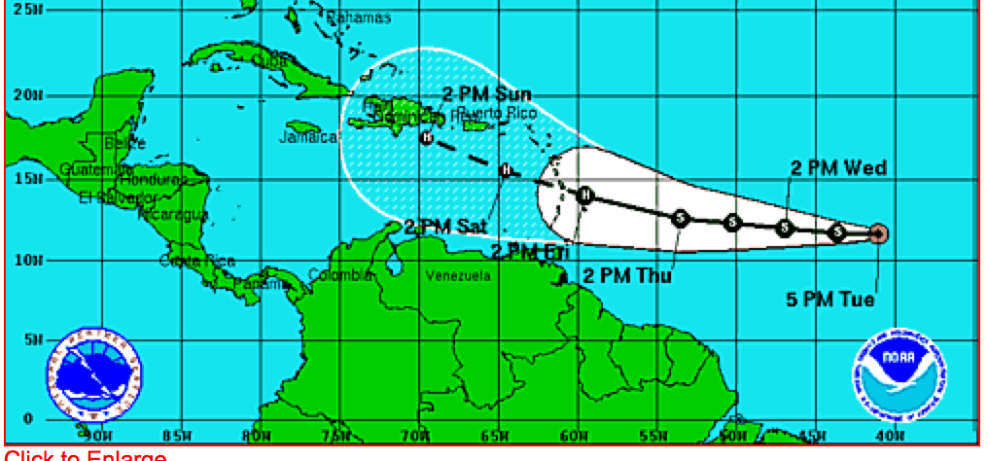
Hurricane Uncertainty Cones
A hurricane uncertainty cone depicts the area having a 67% chance of containing the hurricane track.

Slide 3
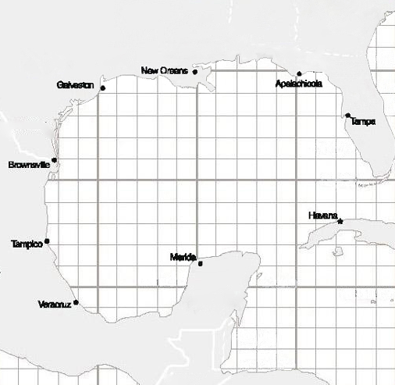
Wu et al. (2014)
Participants reported strike probability judgments (p_{s}) after viewing tracking maps in which hurricane direction was indicated by
Forecast track only,
Uncertainty cone only, or
Forecast track plus uncertainty cone.
Hurricane 1
Track Direction: West
Wind Speed: 85 mph (Category 1)
North
Northwest
Northeast
West
East
Southwest
Southeast
South

Slide 4
Wu et al. (2014) Results
Sector
Track
Track

Slide 5
Wu et al. (2014) Results
Sector
Track
Track
Track
Track
Track

Slide 6
Cox et al. (2013)
Participants viewed uncertainty cones or track ensembles.
A track ensemble is a representative set of hurricane tracks that could potentially occur, given the past history of Gulf hurricanes.
Each track is displayed and gradually disappears while additional tracks are randomly generated from the historical distribution of track directions.

Slide 7
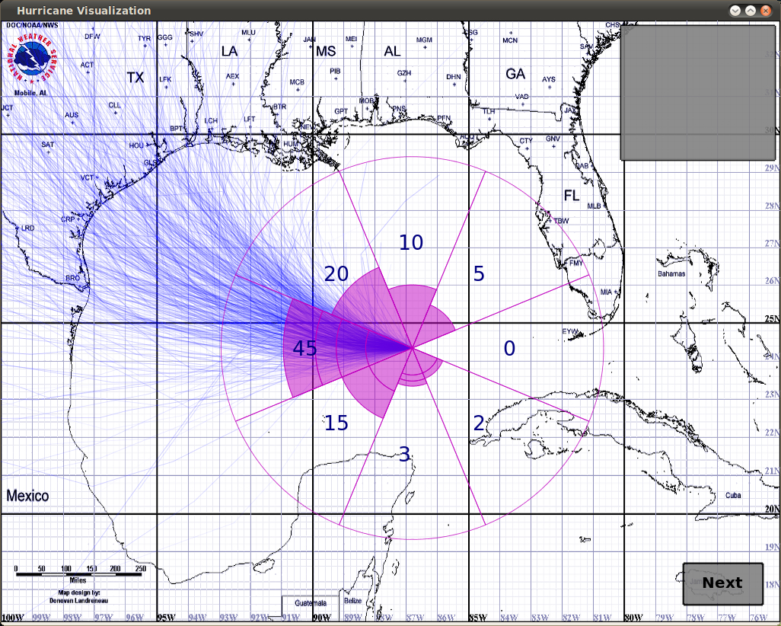

Slide 8
Cox et al. (2013) Results
Judged probability
Judged probability
Most similar scenario
Least similar scenario

Slide 9
Wu et al. (2015, a, b)
Wu et al. examined information search, p_{s} judgments, and protective action recommendations using DynaSearch, a computer system for studying dynamic decision tasks.
DynaSearch can display graphic (e.g., maps), tabular, and textual information.
Display content is made visible by clicking/holding on the desired information element.
DynaSearch is a useful alternative to eye-tracking methods because it can be used to conduct Internet experiments.

Slide 10
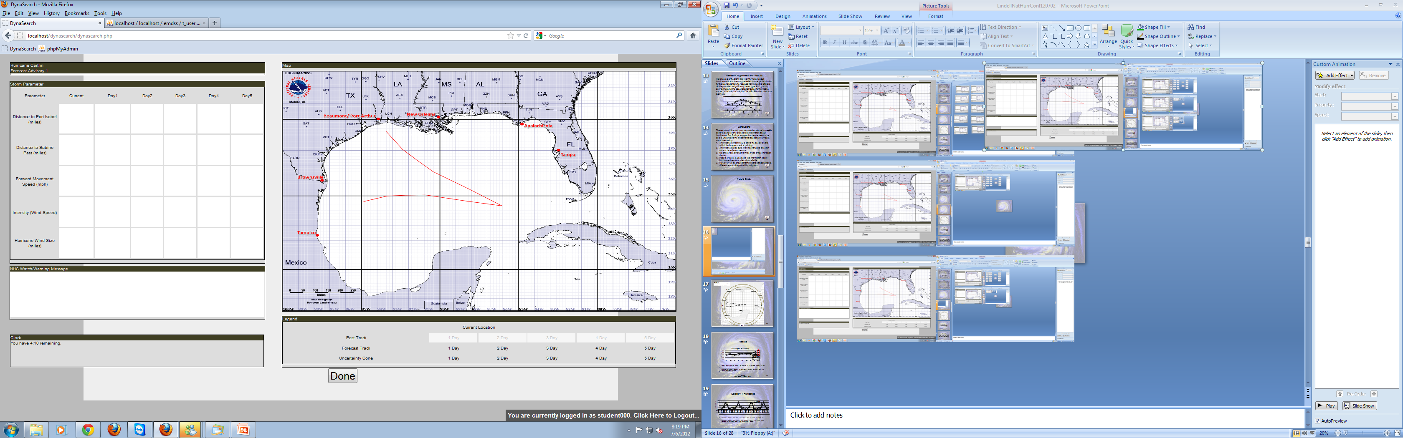
DynaSearch Forecast Advisory Information Display
Note that this user clicked the 5-day uncertainty cone.
Category 3 (120 mph)
A HURRICANE WATCH IS IN EFFECT FROM CAMERON COUNTY, TX TO OKALOOSA COUNTY, AL. A HURRICANE WATCH MEANS THAT HURRICANE CONDITIONS ARE POSSIBLE WITHIN THE WATCH AREA GENERALLY WITHIN 36 HOURS..

Slide 11
Mean p_{s} for Hurricane A (Brownsville)
Target city
Adjacent cities
Remote cities

Slide 12
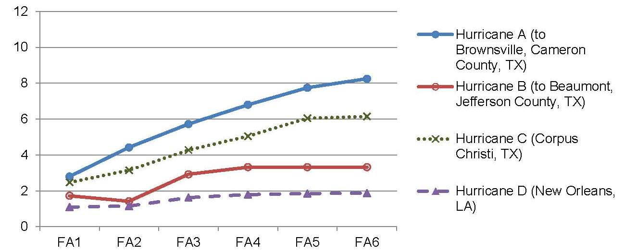
Protective Action Recommendations for Cameron County (Brownsville)

Slide 13
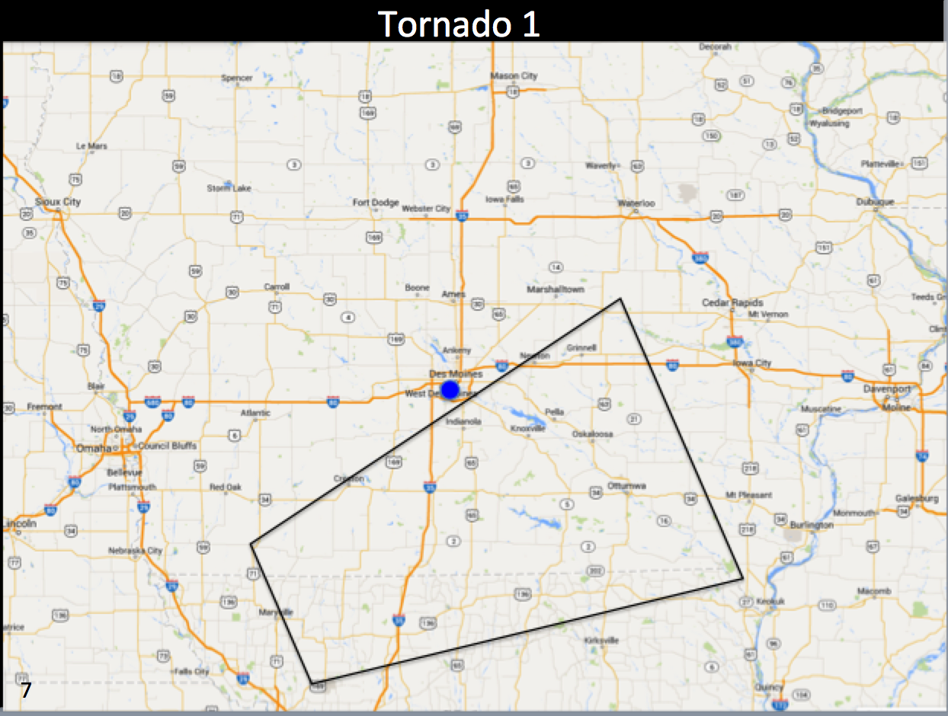
Tornado Warning Polygons
A tornado warning polygon
Depicts the area that a meteorologist thinks is at risk of being struck by a tornado
Is based on expert judgment rather than historical data.

Slide 14
Tornado Warning Polygons
Sherman-Morris and Brown (2012) found respondents tended to judge the area of highest risk to be the centroid of the polygon.
Ash et al. (2014) collected ratings of fear and protective action in response to a standard polygon (1 risk contour), a red gradient polygon (5 risk contours) and spectral polygon (10 risk contours)

Slide 15
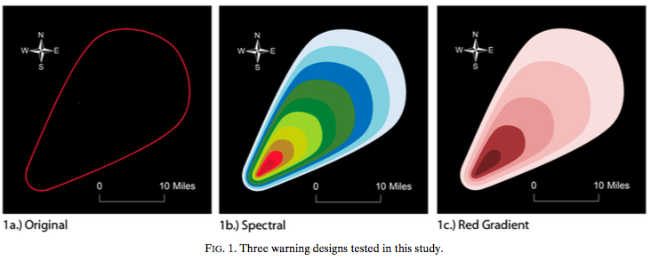
Ash et al. (2014) Three Forms of Polygons

Slide 16
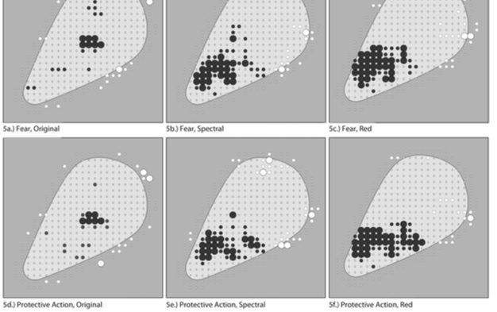
Ash et al. (2014) Results

Slide 17
Lindell et al. (2015)
Participants viewed 15 tornado polygons that varied in proximity to their location.
 | A | B | C | D | E | F | G | H | I
5 |  |  |  |  | 2.38/3.34
4 | 2.49/3.15 | 3.00/4.03 |  |  |  |  |  | 3.11/3.87 | 1.46/1.61
3 | 1.39/2.15 | 2.57/2.81 |  |  | 4.55/4.85 |  | 3.30/3.88
2 |  | 1.39/1.44 |  | 2.99/4.13 | 3.09/4.03 | 2.76/3.35 | 1.93/2.10
1
Note: Extremely unlikely = 1; Extremely likely = 5

Slide 18
Overall Conclusions
People use a distance-decay heuristic to generate a differentiated representation of risk even when viewing a display that has only a single contour.
Participants provided p_{s} judgments that decline with distance from the uncertainty display centerline (hurricane) or centroid (tornado) and are nonzero outside the contour line.
The slope (and scale) of the distance-decay function differs by hazard (miles for tornadoes and hundreds of miles for hurricanes) and person.
The p_{s} judgments are correlated with expected (in experiments) and actual (in surveys) protective actions.

Slide 19
Future Research Needs
Additional research is needed to
Assess the effects of contextual information (e.g., adding storm cells to warning polygons).
Assess people’s perceptions of the probabilities and costs of decision errors.
Examine differences between reactions to a single graphic display and the totality of information received between initial warning and protective action.
Determine if these results also apply to hazards in which topographical features affect personal risk.
Identify the sources of individual differences in the slope/scale of the distance-decay function (e.g., numeracy and spatial ability).
Determine whether general populations can process more complex uncertainty displays without extensive training.

Slide 20
References
Ash, K.D., R.L. Schumann III, and G.C. Bowser, 2014: Tornado warning trade-offs: Evaluating choices for visually communicating risk. Weather, Climate, and Society, 6(1), 104-118.
Broad, K., A. Leiserowitz, J. Weinkle, and M. Steketee, 2007: Misinterpretations of the “cone of uncertainty” in Florida during the 2004 hurricane season. Bulletin of the American Meteorological Society, 88(5), 651-667.
Cox, J., D. House, and M.K. Lindell, 2013: Visualizing uncertainty in predicted hurricane tracks. International Journal for Uncertainty Quantification, 3, 143-156.
Huang, S-K., M.K. Lindell, and C.S. Prater, in press: Who leaves and who stays? A review and statistical meta-analysis of hurricane evacuation studies. Environment and Behavior. DOI: 10.1177/0013916515578485
Lindell, M.K. and T.C. Earle, 1983: How close is close enough: Public perceptions of the risks of industrial facilities. Risk Analysis, 3, 245-253. Reprinted in S. Gerard, R. K. Turner and I. J. Bateman (eds.) Managing the Environment for Sustainable Development Vol. 4, Environmental Risk Planning and Management, Northampton, MA: Elgar (2001), pp. 449-457.

Slide 21
References
Lindell, M.K., S-K. Huang, H-L. Wei, and C.D. Samuelson, 2015: Perceptions and Expected Immediate Reactions to Tornado Warning Polygons. Seattle WA: University of Washington Department of Urban Design and Planning.
Mason J.B. and J.C. Senkbeil, 2014: Implications of the 2011 Tuscaloosa EF4 tornado for shelter and refuge decisions. Natural Hazards DOI: 10.1007/s11069-014-1230-4.
Meyer, R., K. Broad, B. Orlove, and N. Petrovic, 2013: Dynamic simulation as an approach to understanding hurricane risk response: Insights from the Stormview lab. Risk Analysis, 33, 1532–1552.
Mileti, D.S. and E.M. Beck, 1975: Communication in crisis: Explaining evacuation symbolically. Communication Research, 2, 24-49.
Montello, D.R., S.I. Fabrikant, M. Ruocco, and R.S. Middleton, 2003: Testing the first law of cognitive geography on point-display spatializations. In W. Kuhn, M.F. Worboys, and S. Timpf (Eds.): COSIT 2003, LNCS 2825 (pp. 316–331).

Slide 22
References
Nagele, D.E., and J.E. Trainor, 2012: Geographic specificity, tornadoes, and protective action. Weather, Climate, and Society, 4(2), 145-155.
Perry, R.W., M.K. Lindell and M.R. Greene, 1981: Evacuation Planning in Emergency Management. Lexington, MA: Heath Lexington Books.
Sherman-Morris, K., and M.E. Brown, 2012: Experiences of Smithville, Mississippi residents with the 27 April 2011 tornado. National Weather Digest, 36(2), 93-101.
Wu, H-C., M.K. Lindell, and C.S. Prater, 2015, a: Process tracing analysis of hurricane information displays. Risk Analysis. doi: 10.1111/risa.12423
Wu, H-C., M.K. Lindell, and C.S. Prater, 2015, b: Strike probability judgments and protective action recommendations in a dynamic hurricane tracking task. Natural Hazards. doi: 10.1007/s11069-015-1846-z
Wu, H-C., M.K. Lindell, C.S. Prater, and C.D. Samuelson, 2014: Effects of track and threat information on judgments of hurricane strike probability. Risk Analysis, 34, 1025-1039.

Slide 23
Questions?

